Slide 1
Big Mountain Resort
Brady Pearce

Slide 2
Problem Identification
Big Mountain Resort’s pricing strategy is to charge a premium over average pricing in its market segment
As an alternative, a data based pricing structure which takes in to account a number of factors such as geography and resort features will be explored
Data describing various resorts and their feature and pricing will be used to develop a model to correlate the most influential data with ticket prices

Slide 3
Recommendation
According to market analysis, our current price of $81 for an adult ticket is well below our expected price. The model suggests that Big Mountain Resort should be charging a ticket price of $95.
Modeling showed that closing one of the runs as a cost-cutting measure would not have an effect on the expected ticket pricing

Slide 4
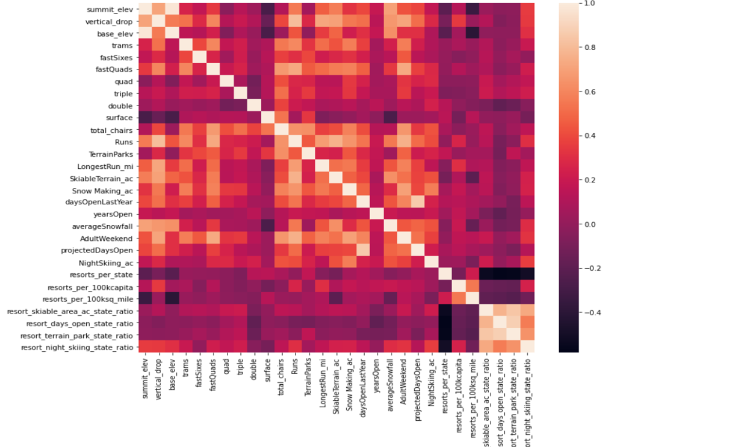
Modeling
The figure to the right shows a heatmap showing correlation of the various parameters
Focusing on ticket pricing, we can see that the factors that have the most influence are number of runs, fast quad lift chairs, vertical drop and total acreage of snow making

Slide 5
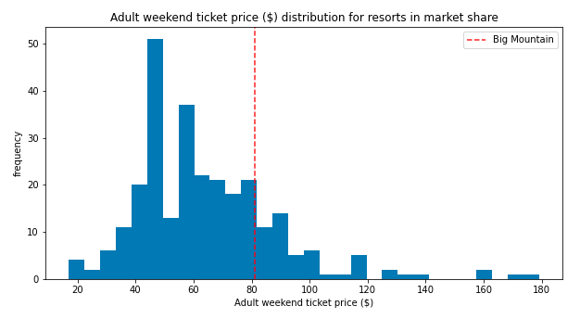
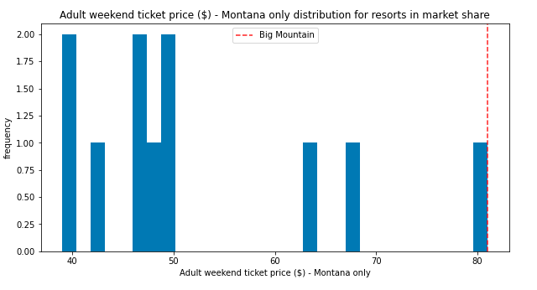
Modeling
Shown on the right is the ticket pricing distribution for typical ski resorts
At first glance, our resort is priced a the higher end of the distribution, and is the highest priced resort in Montana
The next slide will show that our resort has amenities that justify this pricing as well as an even higher price

Slide 6
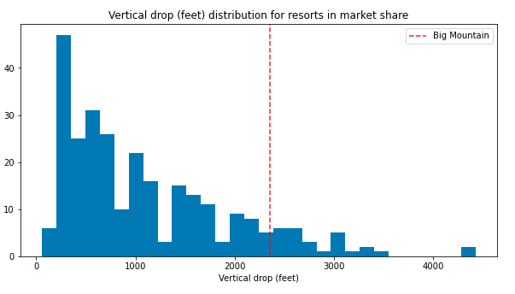
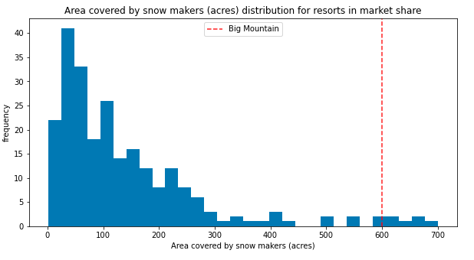
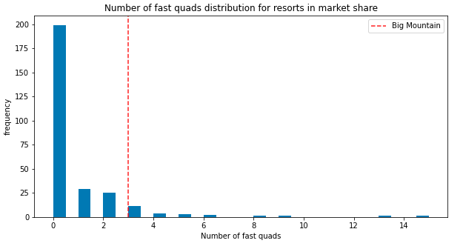
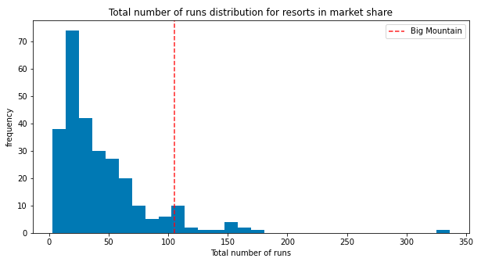
Modeling
Big Mountain Resort sits on the high end of the distribution for the most influential factors in ticket pricing

Slide 7
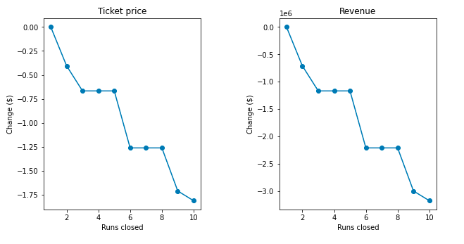
Modeling
One cost cutting option that would not reduce expected ticket price would be to close one of our least used runs
As seen to the right, closing one run has no effect on expected ticket price or the revenue expected for our resort

Slide 8
Summary and Conclusion
Big Mountain resort’s pricing structure is neglecting to take into account the extent of the amenities the resort is offering compared to market average.
Our modeling suggests that the ticket price should be increased to $95 dollars.
We also found that closing one run to cut costs would not have an effect on expected ticket pricing.

